Slide 1
Introduction
CSC 4232 Machine Learning
Semester: Fall 2024-25
Prerequisite: Artificial Intelligence & Expert System
Dr. Ashraf Uddin
Assistant Professor
Mail: dr.ashraf@aiub.edu
Room: DN0613
Course Materials:
https://tinyurl.com/ml-fall-24-25

Slide 2
Vision & Mission of AIUB
Vision
AMERICAN INTERNATIONAL UNIVERSITY-BANGLADESH (AIUB) envisions promoting professionals and excellent leadership catering to the technological progress and development needs of the country.
Mission
AMERICAN INTERNATIONAL UNIVERSITY-BANGLADESH (AIUB) is committed to provide quality and excellent computer-based academic programs responsive to the emerging challenges of the time. It is dedicated to nurture and produce competent world class professional imbued with strong sense of ethical values ready to face the competitive world of arts, business, science, social science and technology.

Slide 3
Goals of AIUB
Sustain development and progress of the university
Continue to upgrade educational services and facilities responsive of the demands for change and needs of the society
Inculcate professional culture among management, faculty and personnel in the attainment of the institution's vision, mission and goals
Enhance research consciousness in discovering new dimensions for curriculum development and enrichment
Implement meaningful and relevant community outreach programs reflective of the available resources and expertise of the university
Establish strong networking of programs, sharing of resources and expertise with local and international educational institutions and organizations
Accelerate the participation of alumni, students and professionals in the implementation of educational programs and development of projects designed to expand and improve global academic standards.

Slide 4
Vision & Mission of Computer Science Department
Vision
Provides leadership in the pursuit of quality and excellent computer education and produce highly skilled and globally competitive IT professionals
Mission
Committed to educate students to think analytically and communicate effectively; train them to acquire technological, industry and research-oriented accepted skills; keep them abreast of the new trends and progress in the world of information communication technology; and inculcate in them the value of professional ethics.

Slide 5
Goals of Computer Science Department
Enrich the computer education curriculum to suit the needs of the industry- wide standards for both domestic and international markets
Equip the faculty and staff with professional, modern technological and research skills
Upgrade continuously computer hardware's, facilities and instructional materials to cope with the challenges of the information technology age
Initiate and conduct relevant research, software development and outreach services.
Establish linkage with industry and other IT-based organizations/institutions for sharing of resources and expertise, and better job opportunities for students.

Slide 6
Course Evaluation
Mid | Attendance | 10 | 40
 | Quiz | 15
 | Assignment | 15
Final | Attendance | 10 | 60
 | Quiz | 15
 | Project Implementation | 15
 | Project Presentation | 20
Grand |  |  | 100

Slide 7
Classroom Policies
Must be present inside the class in due time.
No class break in this course
Every class will start with a question-answer session about the last lecture. So students must be prepared with the contents and exercises from the last lecture.
Students are suggested to ask questions during or after the lecture.
Additional/bonus marks may be given to any good performances during the class.
Late in Class:
Student coming after 5 minutes of due time is considered late.
2 late attendances are considered as one absent.
Late during quiz are not given additional time.
Students who are regularly late might have additional deduction of marks.
A late student will be allowed to enter the class.
Don’t ask permission to enter the class, just get in slowly and silently.
You can not get out from the class without permission.

Slide 8
Attendance
At least 80% presence is required by the student. Absent classes must be defended by the student through application and proper documentation to the course teacher.
Single absences or absences within 25% range will be judged by the course teacher.
Long absences/irregular presence/absences out of 25% range must go through application procedures via department Head (+ probation office, if student is in probation) to attend the following classes.
Acceptance of an application for absence only gives permission to attend the following classes. This might still result in deduction of marks (for attendance) which will be judged by the course teacher.

Slide 9
Grading Policies
All the evaluation categories & marks will be uploaded to the VUES within one week of the evaluation process except the attendance, which will be uploaded along with the major (mid/final term) written exam marks.
Letter grades ‘A+’ through ‘F’ is counted as grades. Other grades ‘I’ and ‘UW’ are considered as temporary grades which are counted/calculated as ‘F’ grade in the CGPA. These grades must/will be converted to the actual grades, i.e. ‘A+’ through ‘F’.
‘I: INCOMPLETE’ is given to students who have missed at most 30% of evaluation categories (quiz/assignment/etc.). Students must contact the course teacher for makeup, through valid application procedures immediately after grade release.
‘UW: UNOFFICIAL WITHDRAW’ is given when the missing evaluation categories are too high (more than 30%) to makeup. A student getting ‘UW’ has no option but to drop the course immediately after grade release

Slide 10
Finally
For any missing evaluation (quiz, assignment, etc.), classes, deadlines, etc. must contact the teacher immediately after missing in the consulting hour, via email, or in unavoidable circumstances.
Any kind of dishonesty, plagiarism, misbehavior, misconduct, etc. will not be tolerated. Might result in deduction of marks, ‘F’ grade, or reported to the AIUB Disciplinary Committee for drastic punishment.
Always check/visit the AIUB home page for notices, rules & regulations of academic/university policies and important announcement for deadlines (Course drop, Exam permit, Exam Schedule, etc.).

Slide 11
Course Objective
This course introduces basic concepts and algorithms in machine learning and neural networks.
The main reason for studying computational learning is to make better use of powerful computers to learn knowledge (or regularities) from the raw data.
At the end of the course, students are expected to be familiar with the theories and paradigms of computational learning, and capable of implementing basic learning systems.

Slide 12
Course Objective
Topics include:
(i) Supervised learning (parametric/non-parametric algorithms, support vector machines, kernels, neural networks).
(ii) Unsupervised learning (clustering, dimensionality reduction, deep learning). (iii) Best practices in machine learning (bias/variance theory; innovation process in machine learning and AI).
This course will also look into a variety of artificial neural networks in terms of architectures and learning algorithms and discuss as many successful real-world applications as possible.
Fundamental concepts and tools underlying machine learning and hands-on experience with implementation of some machine learning algorithms applied to real world cases.
Research issues as well as machine learning strategies and issues relating specific industrial sectors.

Slide 13
Importance of the course
Studying ML/AI opens a world of opportunities.
At a basic level, you’ll better understand the systems and tools that you interact with daily. And if you stick with the subject and study more, you can help create cutting edge ML/AI applications, like the Google Self Driving Car, or IBM’s Watson.
In the field of artificial intelligence, the possibilities are truly endless.
Studying ML/AI now can prepare you for a job as a researching neural networks, human-machine interfaces, and quantum artificial intelligence.
Or you could work as a software engineer in industry working for companies like Amazon to shopping list recommendation engines or Facebook analyzing and processing big data.
You could also work as a hardware engineer developing electronic parking assistants or home assistant robots.

Slide 14
Importance of the course
Studying ML/AI opens a world of opportunities.
At a basic level, you’ll better understand the systems and tools that you interact with daily. And if you stick with the subject and study more, you can help create cutting edge ML/AI applications, like the Google Self Driving Car, or IBM’s Watson.
In the field of artificial intelligence, the possibilities are truly endless.
Studying ML/AI now can prepare you for a job as a researching neural networks, human-machine interfaces, and quantum artificial intelligence.
Or you could work as a software engineer in industry working for companies like Amazon to shopping list recommendation engines or Facebook analyzing and processing big data.
You could also work as a hardware engineer developing electronic parking assistants or home assistant robots.

Slide 15
Introduction to Machine Learning
Definition of Machine Learning (ML)
Differences between AI, ML, and Deep Learning
Real-world applications of ML (e.g., image recognition, natural language processing, recommendation systems)

Slide 16
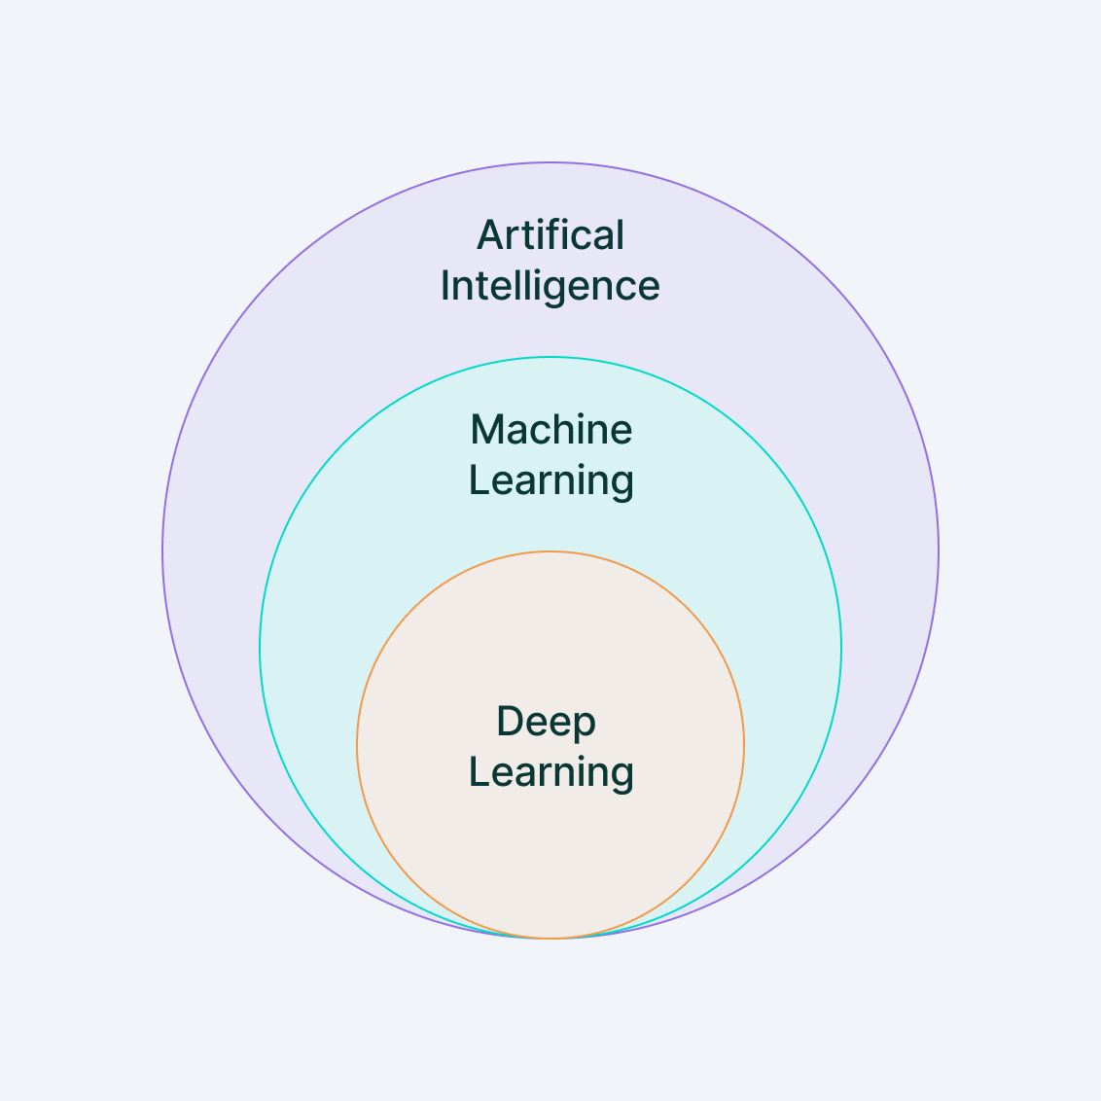
Machine Learning
Machine Learning (ML) is a branch of artificial intelligence (AI) that focuses on building systems that can learn from data, identify patterns, and make decisions with minimal human intervention.
In essence, machine learning allows computers to "learn" from past experiences (data) and improve their performance over time without being explicitly programmed for every possible scenario.
https://www.v7labs.com/blog/machine-learning-guide

Slide 17
Machine Learning: Applications
Image Recognition:
Facial Recognition: Used in smartphones, social media platforms (e.g., Facebook photo tagging), and security systems. ML algorithms can detect and recognize human faces in images or videos.
Medical Imaging: ML is used in analyzing X-rays, MRIs, and CT scans to identify abnormalities such as tumors, fractures, or other diseases.
Object Detection: Used in autonomous vehicles, retail (e.g., Amazon Go stores), and security surveillance systems.

Slide 18
Machine Learning: Applications
Speech and Voice Recognition:
Virtual Assistants: ML powers virtual assistants like Siri, Alexa, and Google Assistant, enabling them to recognize and respond to voice commands.
Speech-to-Text: Applications like Google Voice Typing and automated transcription services convert spoken words into written text.
Voice Biometrics: Used in security systems for identifying individuals based on their voice.

Slide 19
Machine Learning: Applications
Natural Language Processing (NLP):
Chatbots and Customer Support: ML-driven chatbots can understand and respond to customer queries, improving customer service for companies like banks, e-commerce platforms, and service providers.
Language Translation: Google Translate and other language translation apps use ML models to translate text and speech between different languages.
Sentiment Analysis: Businesses use ML to analyze customer reviews, social media posts, and other text data to determine public sentiment or opinions about products or services.

Slide 20
Machine Learning: Applications
Recommendation Systems:
E-commerce: Platforms like Amazon and Alibaba use ML to recommend products based on a user’s browsing history, purchase behavior, and preferences.
Streaming Services: Netflix, Spotify, and YouTube recommend movies, music, and videos by analyzing user interactions, viewing history, and preferences.
Social Media: Facebook, Twitter, and Instagram use recommendation algorithms to suggest friends, posts, or content that align with a user’s interests.

Slide 21
Machine Learning: Applications
Fraud Detection:
Banking and Finance: ML algorithms analyze transaction patterns to detect fraudulent activities, such as credit card fraud, money laundering, or account takeovers.
Insurance: Insurers use ML to detect fraudulent insurance claims by spotting unusual patterns or behaviors in claim submissions.
Autonomous Vehicles:
Self-Driving Cars: Companies like Tesla, Waymo, and Uber use ML to help autonomous vehicles interpret their surroundings (e.g., detecting pedestrians, road signs, and other cars), make driving decisions, and navigate safely.
Drone Navigation: ML is used in drones for route planning, object detection, and collision avoidance.

Slide 22
Machine Learning: Applications
Healthcare and Medical Diagnosis:
Disease Prediction: ML models help predict the likelihood of diseases such as diabetes, heart disease, or cancer by analyzing patient data.
Personalized Medicine: Machine learning enables the development of personalized treatment plans based on a patient's genetics, medical history, and current health data.
Drug Discovery: ML accelerates the process of discovering new drugs by analyzing data from clinical trials and identifying potential drug candidates.
Finance and Stock Market Analysis
Marketing and Advertising
Supply Chain Optimization
Gaming, Robotics, Cybersecurity
Personalization
Energy Efficiency

Slide 23
Types of Machine Learning
Supervised Learning
Unsupervised Learning
Semi-supervised Learning
Reinforcement Learning

Slide 24
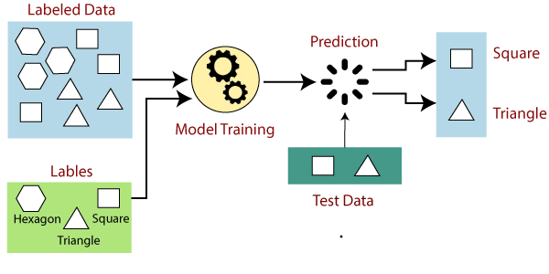
Types of Machine Learning
Supervised Learning
In supervised learning, the model is trained on labeled data, meaning that each training example has both input data and a corresponding correct output (label).
The goal is for the model to learn the mapping from inputs to outputs so that it can predict the output for new, unseen data.
https://www.javatpoint.com/supervised-machine-learning

Slide 25
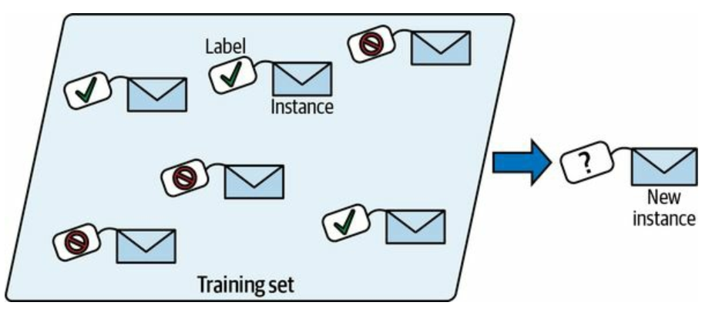
Types of Machine Learning
Supervised Learning
In supervised learning, the model is trained on labeled data, meaning that each training example has both input data and a corresponding correct output (label).
The goal is for the model to learn the mapping from inputs to outputs so that it can predict the output for new, unseen data.
Example: Spam detection in emails, where the model is trained on labeled emails (spam or not spam).

Slide 26
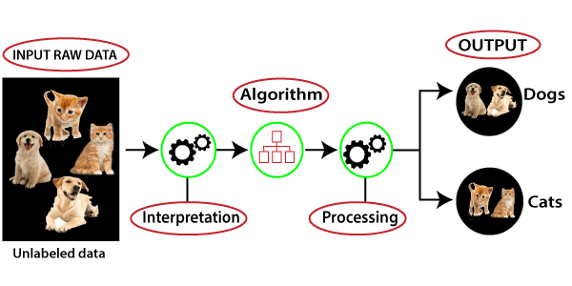
Types of Machine Learning
Unsupervised Learning
In unsupervised learning, the model is given data without explicit labels. It tries to learn the structure of the data and discover hidden patterns or groupings.
Example: Customer segmentation, where the goal is to group customers based on purchasing behavior without knowing any predefined categories.
https://www.javatpoint.com/unsupervised-machine-learning

Slide 27
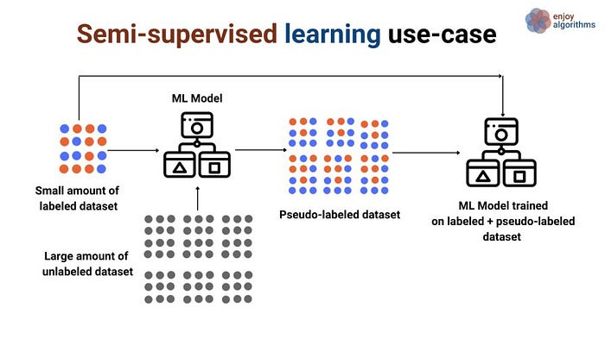
Types of Machine Learning
Semi-supervised Learning
This method uses a small amount of labeled data combined with a large amount of unlabeled data. The model leverages the unlabeled data to improve its learning efficiency.
Example: Image classification where only a few images are labeled, but many unlabeled images are available.
https://medium.com/@gayatri_sharma/a-gentle-introduction-to-semi-supervised-learning-7afa5539beea

Slide 28
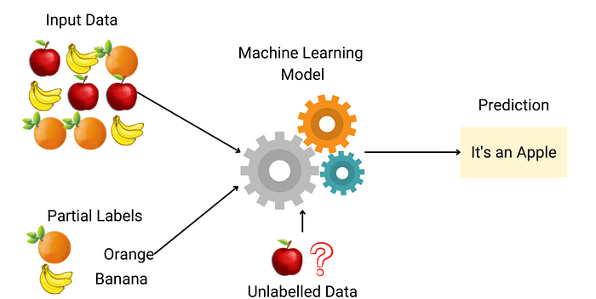
Types of Machine Learning
Semi-supervised Learning
This method uses a small amount of labeled data combined with a large amount of unlabeled data. The model leverages the unlabeled data to improve its learning efficiency.
Example: Image classification where only a few images are labeled, but many unlabeled images are available.
https://medium.com/@gayatri_sharma/a-gentle-introduction-to-semi-supervised-learning-7afa5539beea

Slide 29
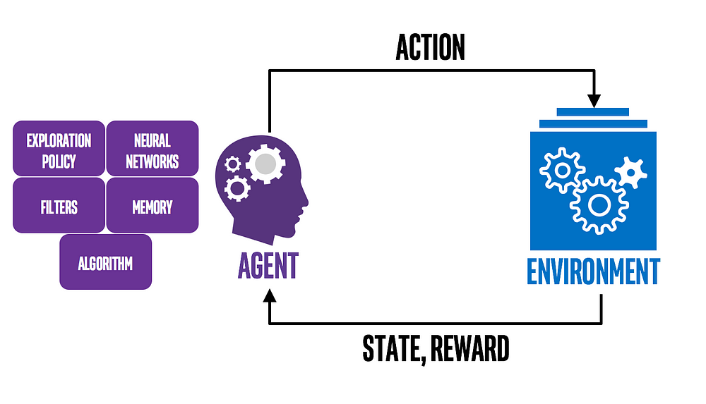
Types of Machine Learning
Reinforcement Learning
In reinforcement learning, an agent interacts with an environment and learns by receiving feedback in the form of rewards or penalties. The agent aims to maximize cumulative rewards by learning the optimal set of actions to take in different situations.
Example: Training a robot to navigate through a maze by rewarding it for reaching the end.
https://medium.com/ai%C2%B3-theory-practice-business/reinforcement-learning-part-1-a-brief-introduction-a53a849771cf

Slide 30
Types of Machine Learning
Reinforcement Learning: Example
Determining the Placement of Ads on a Web Page
Agent: The program making decisions on how many ads are appropriate for a page.
Environment: The web page.
Action: One of three:
(1) putting another ad on the page;
(2) dropping an ad from the page;
(3) neither adding nor removing.
Reward: Positive when revenue increases; negative when revenue drops.
In this scenario, the agent observes the environment and gets its current status. The status can be how many ads there are on the web page and whether or not there is room for more.
The agent then chooses which of the three actions to take at each step. if programmed to get positive rewards whenever the revenue increase, and negative rewards whenever revenue falls, it can develop its effective policy.
https://medium.com/ai%C2%B3-theory-practice-business/reinforcement-learning-part-1-a-brief-introduction-a53a849771cf

Slide 31
Types of Machine Learning
Supervised, Unsupervised, and Reinforcement Learning: What are the Differences?
Difference #1: Static Vs. Dynamic
The goal of supervised and unsupervised learning is to search for and learn about patterns in training data, which is quite static. RL, on the other hand, is about developing a policy that tells an agent which action to choose at each step — making it more dynamic.
Difference #2: No Explicit Right Answer
In supervised learning, the right answer is given by the training data. In Reinforcement Learning, the right answer is not explicitly given: instead, the agent needs to learn by trial and error. The only reference is the reward it gets after taking an action, which tells the agent when it is making progress or when it has failed.
https://medium.com/ai%C2%B3-theory-practice-business/reinforcement-learning-part-1-a-brief-introduction-a53a849771cf

Slide 32
Key Concepts in Machine Learning
Data and Features: input data, features, labels
Model and Algorithm: what is a model, common ML algorithms
Training and Testing: data splitting (train-test-validation sets)
Loss Function: error measurement, cost function
Optimization: gradient descent basics

Slide 33
Learning Process
How a model learns: data → algorithm → model
Model evaluation metrics: accuracy, precision, recall, F1 score
Overfitting and underfitting: bias-variance tradeoff

Slide 34
Fundamental Algorithms Overview
Linear Regression
Logistic Regression
Decision Trees
k-Nearest Neighbors (k-NN)
Briefly introduce more advanced methods (e.g., Neural Networks, Support Vector Machines)

Slide 35
Challenges in Machine Learning
Data quality and quantity
Feature engineering and selection
Interpretability and explainability of models
Scalability and performance

